Slide 1
Assignment reminders:
Check Canvas for comments on your PLC submissions
Check Canvas for comments on Group project topics
6/11 groups chose the same topic of protein folding and prion disease
2/11 groups chose gene mutations in sickle cell disease

Slide 2
Group Project Topics So Far
Group 1:
Group 2: DNA replication defects in Huntington’s disease
Group 3: Exocytosis (or cellular response) and blood clotting
Group 4:
Group 5: Gene editing (DNA damage repair) techniques to correct disease-causing mutations in embryos
Group 6:
Group 7: Chromosome segregation defects in Down Syndrome
Group 8: Cell signaling (maybe inflammation and autophagy) in MS
Group 9: Cell signaling and autoimmune disorders (Myasthenia gravis)
Group 10: Gene mutations and protein translation in Cystic Fibrosis
Group 11:

Slide 3
Assignment reminders:
Check Canvas for comments on your PLC submissions
Check Canvas for comments on Group project topics
6/11 groups chose the same topic of protein folding and prion disease
2/11 groups chose gene mutations in sickle cell disease
Attend Seminar #1 and turn in question sheet Tomorrow 4PM
Gateway Park: 60 Prescott St. Seminar room 1002
Sign-in sheet in back of room
Seminar will end ~5pm

Slide 4
Lecture 6 Objectives
Understand and be able to describe the dynamic nature of chromatin structure throughout the cell cycle
Understand and be able to provide examples of how and why chromatin access is regulated
Understand and be able to describe replication challenges and the cell’s solutions to these challenges, including:
Replication priming
Supercoiling
Replicating chromosome ends
Understand common types of DNA damage and how they are repaired
Be able to describe limitations to different DNA damage repair mechanisms

Slide 5
Structure and organization of chromatin
-continued-

Slide 6
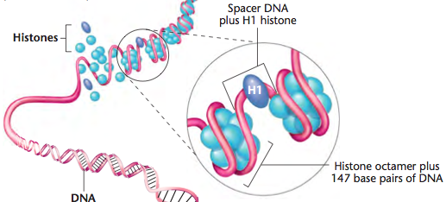
Nucleosomes
Basic unit of chromosome structure
Chromatin is wrapped around an octamer of proteins known as histones histones + DNA = nucleosome
A 5th histone (H1)
binds the ‘linker
region’ between
nucleosomes →
chromatin fiber
Histones are essential and the most highly conserved proteins between species

Slide 7
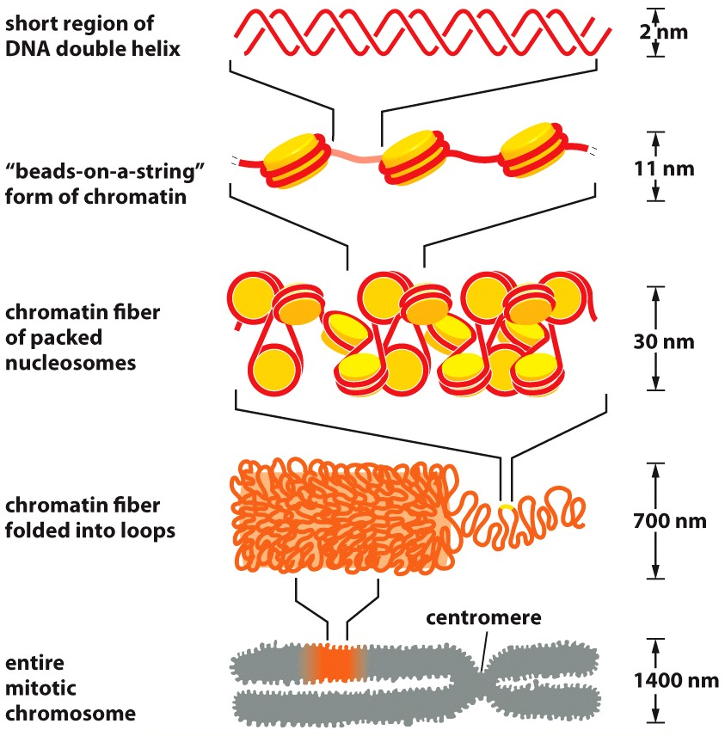
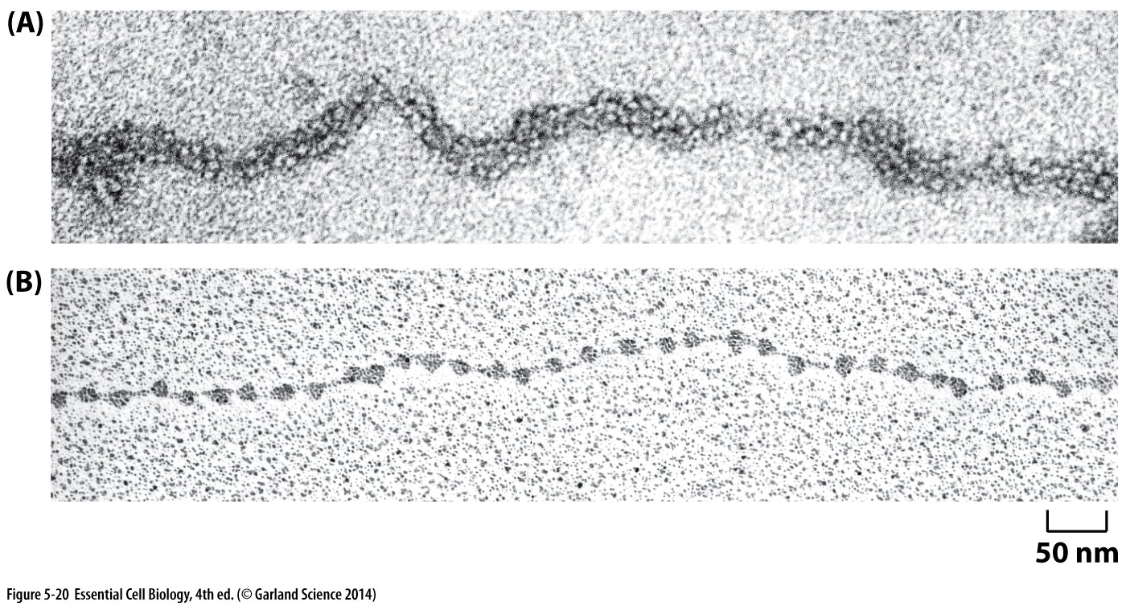
Imaging chromatin
Electron Microscopy to see chromatin

Slide 8
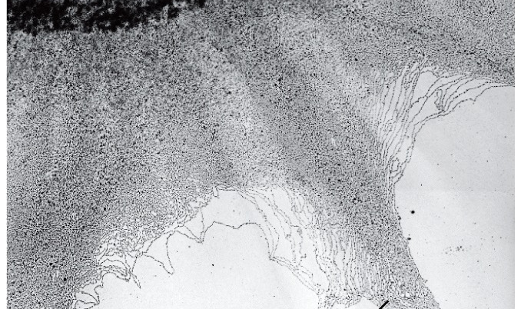
DNA in chromosomes is always highly condensed
Chromatin fibers spilling out of a broken nucleus

Slide 9
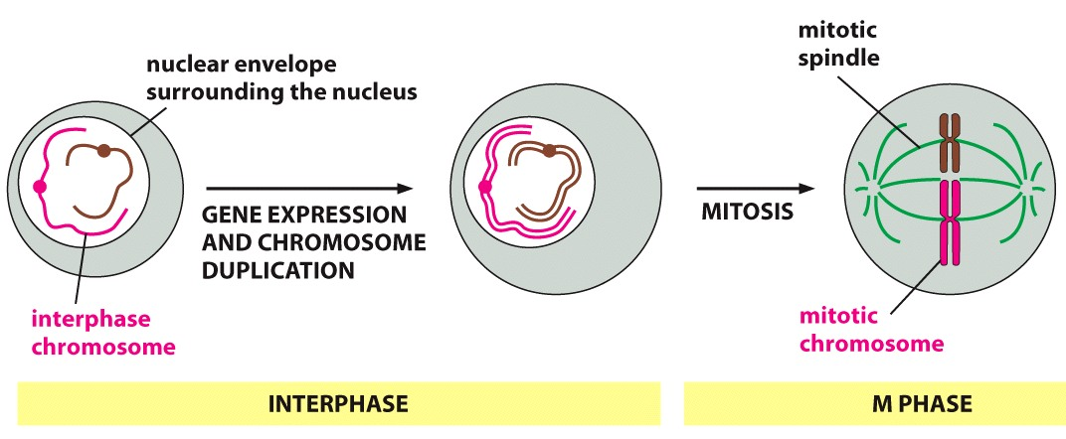
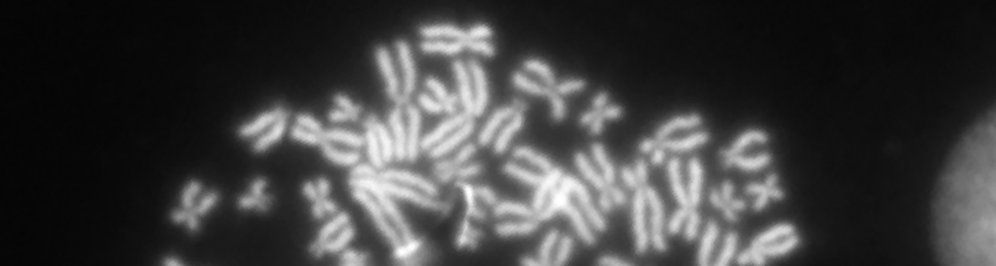
Condensation for cell division
Dramatic changes in chromosome condensation mark the onset of mitotic cell division

Slide 10
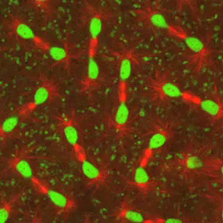
Chromatin structure is Dynamic
Many nuclei in a single drosophila embryo undergoing rapid cell cycle divisions

Slide 11
Regulation of compaction
Controlling access to DNA

Slide 12
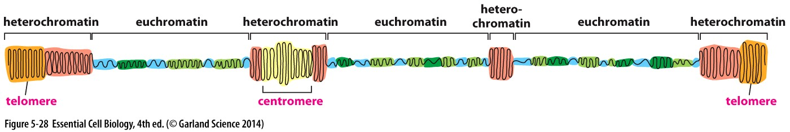
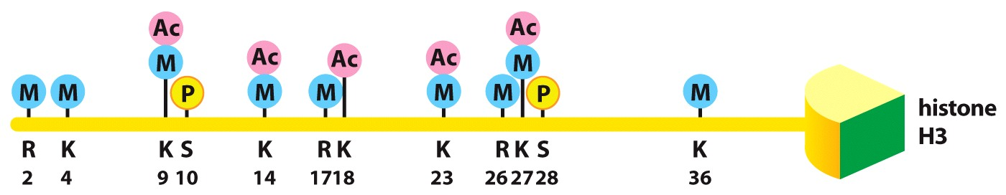
Regulation of structure within a chromosome
Structure and compaction varies along a single chromosome:
Heterochromatin: compact, transcriptionally silent (no RNA made)
Euchromatin: less compact, transcriptionally active (RNA made)
Pattern of chromatin compaction is dictated by histone code:
Post translational modification of histones → influence protein binding partners

Slide 13
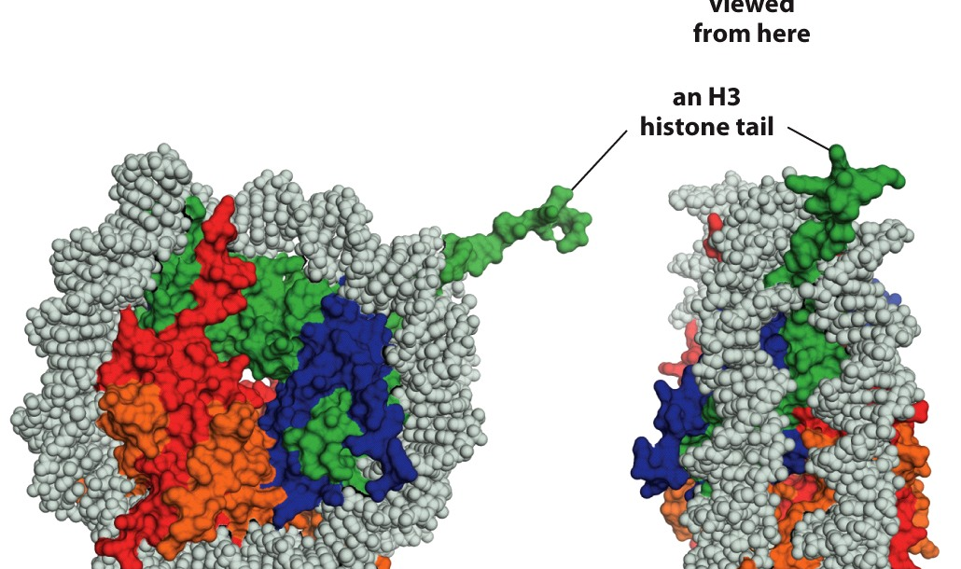
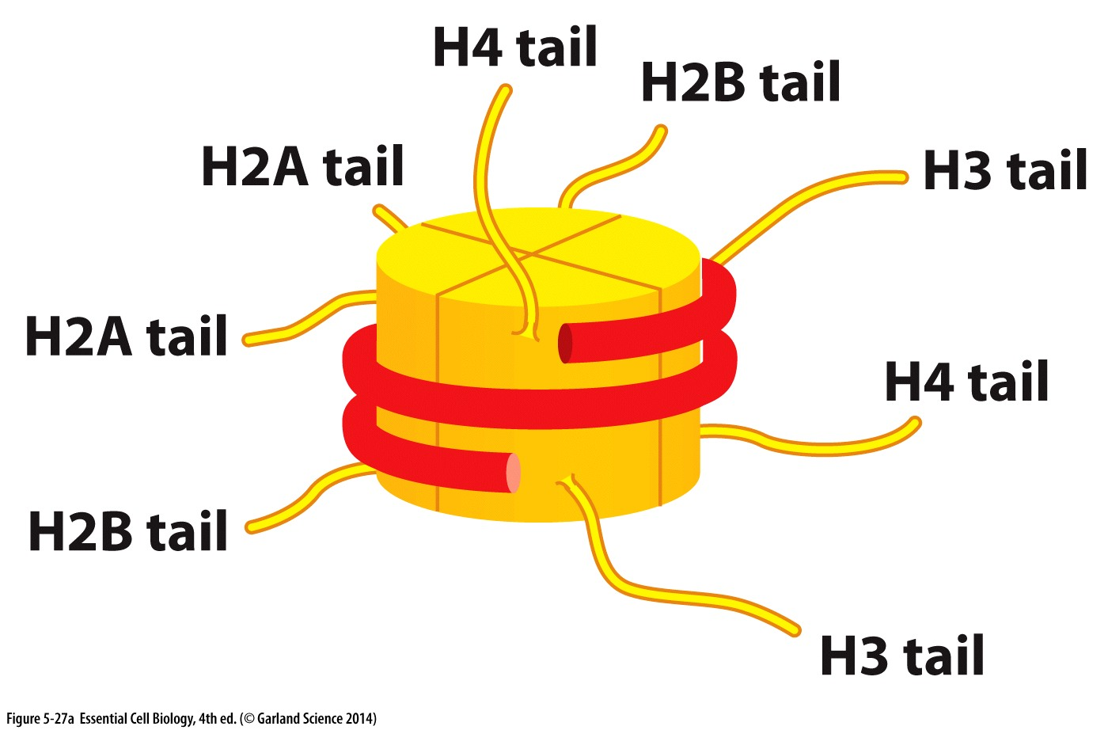
Regulation by histone tails
Chromatin wraps around histone octamer
Histone ‘tails’ remain exposed
Unstructured regions

Slide 14
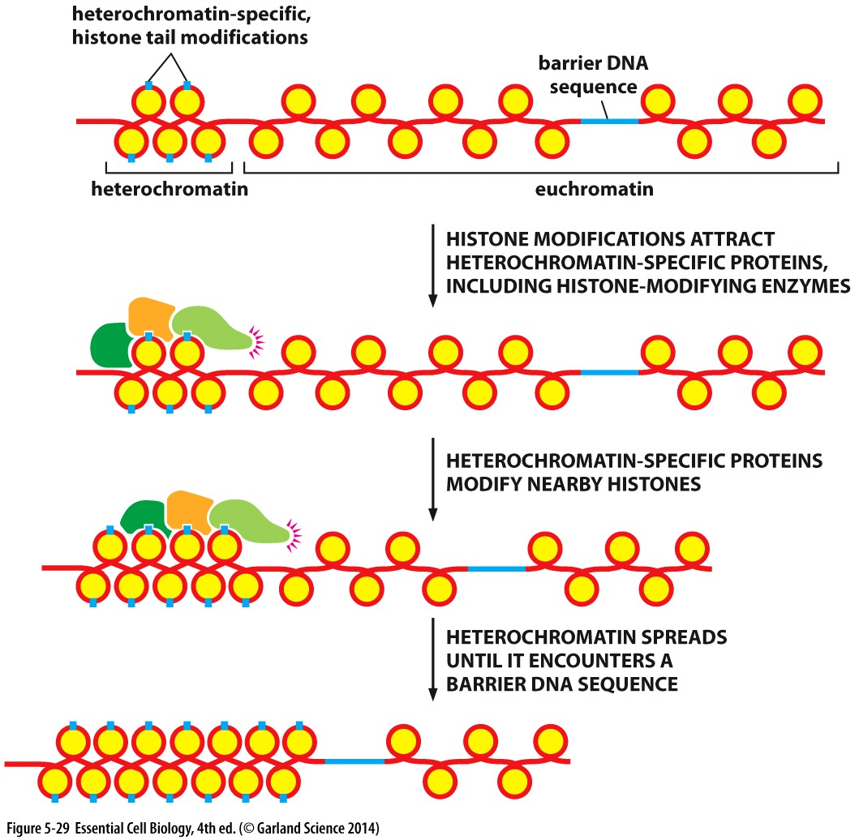
Histone Code
Pattern of modifications on the histone tails
Different modifications for recruitment of different chromatin-modifying proteins
Regulate:
Nucleosome spacing
Formation and maintenance of heterochromatic regions
Gene expression/silencing

Slide 15
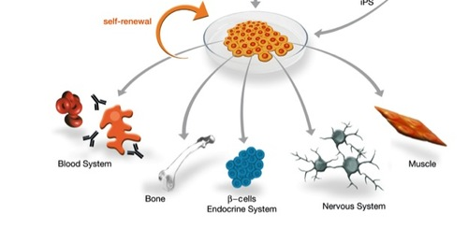
Histone Code
Informs cell identity
Non genetic but still HERITABLE- How cells from the same organism (same DNA) can have different functions (heart cell vs skin cell vs neuron)
Same DNA, dramatically different cell fates

Slide 16
Replication machine

Slide 17
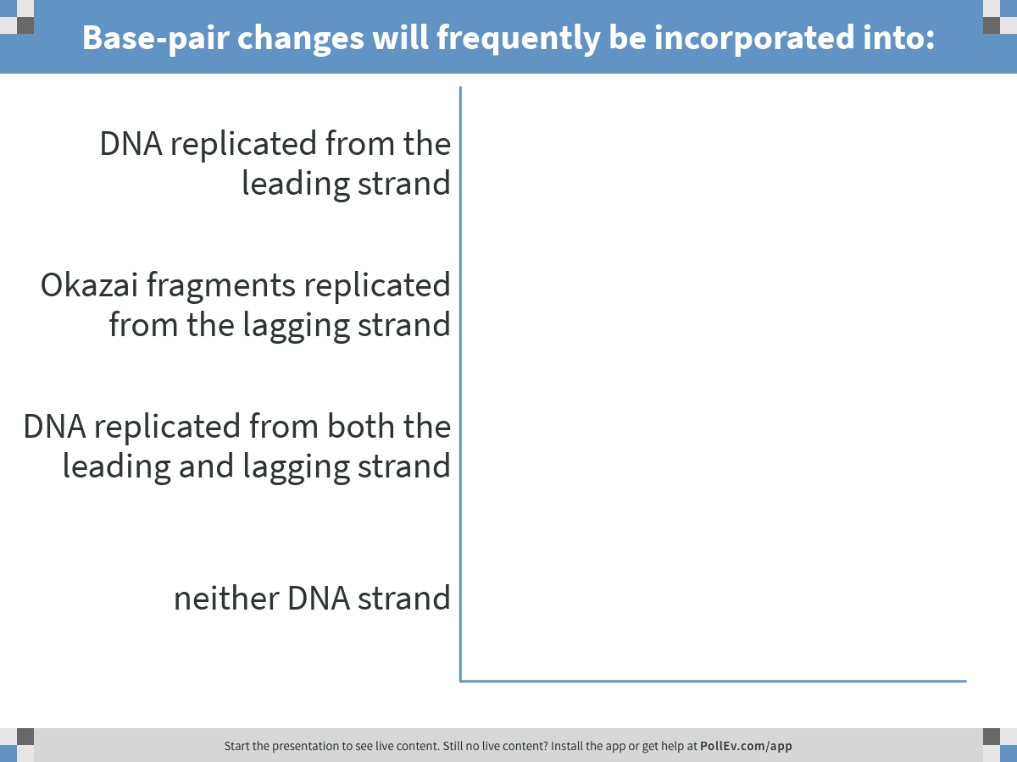
RNA polymerase is error prone. What does this mean for replication?
Notes:
Base-pair changes will frequently be incorporated into:
https://www.polleverywhere.com/multiple_choice_polls/O5vRcnWLYAs1Ig5

Slide 18
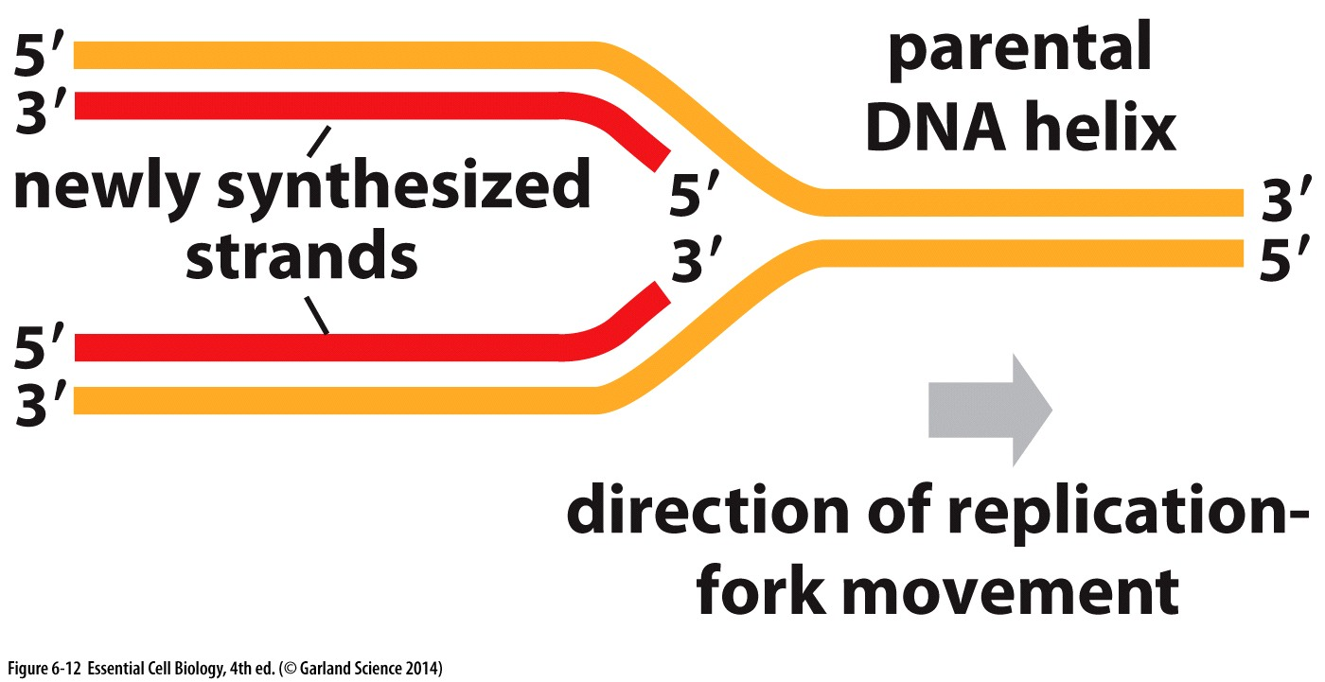
Replication requires the cooperation of many proteins
Helicase to unwind DNA at the fork

Slide 19
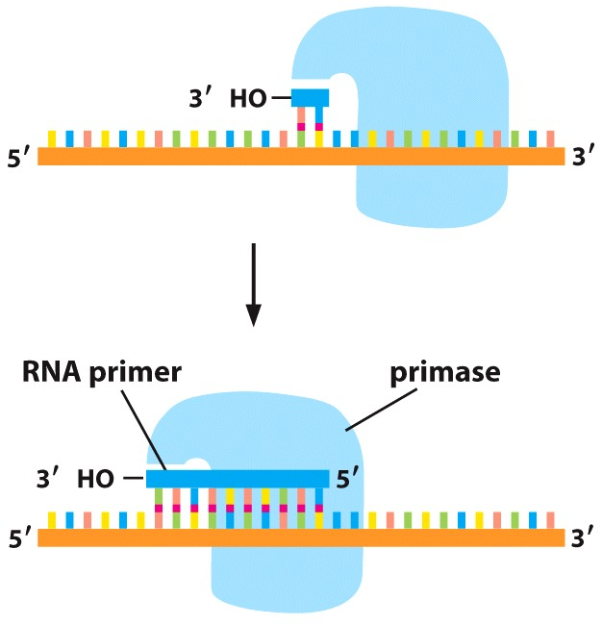
Replication requires the cooperation of many proteins
DNA polymerase (primase) requires a 3’ base-paired end to start
RNA polymerase can start with only a template strand
DNA template
RNA polymerase to place an RNA primer

Slide 20
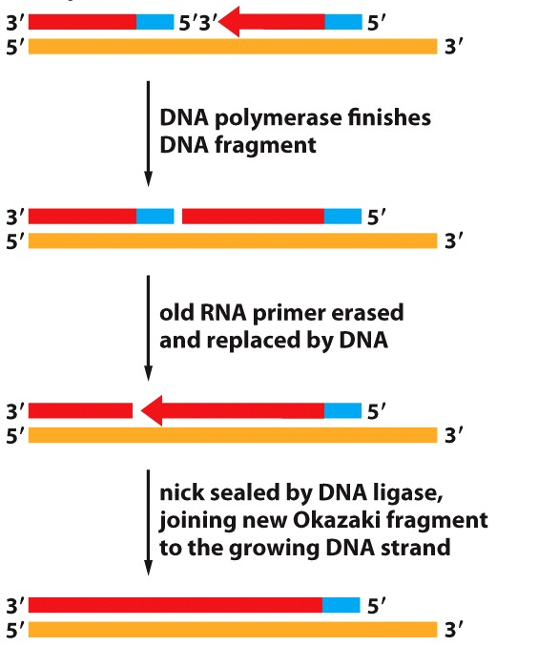
Replication requires the cooperation of many proteins
RNA polymerase to place an RNA primer
Nuclease to degrade the RNA primer
Ligase to join together fragments

Slide 21
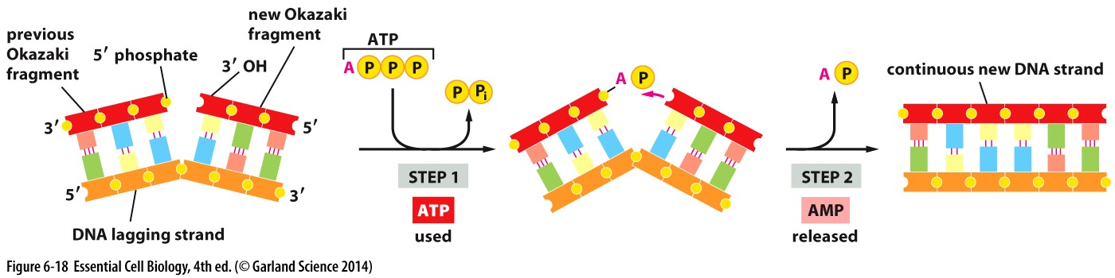
Replication requires the cooperation of many proteins
RNA polymerase to place an RNA primer
Nuclease to degrade the RNA primer
Ligase to join together fragments

Slide 22
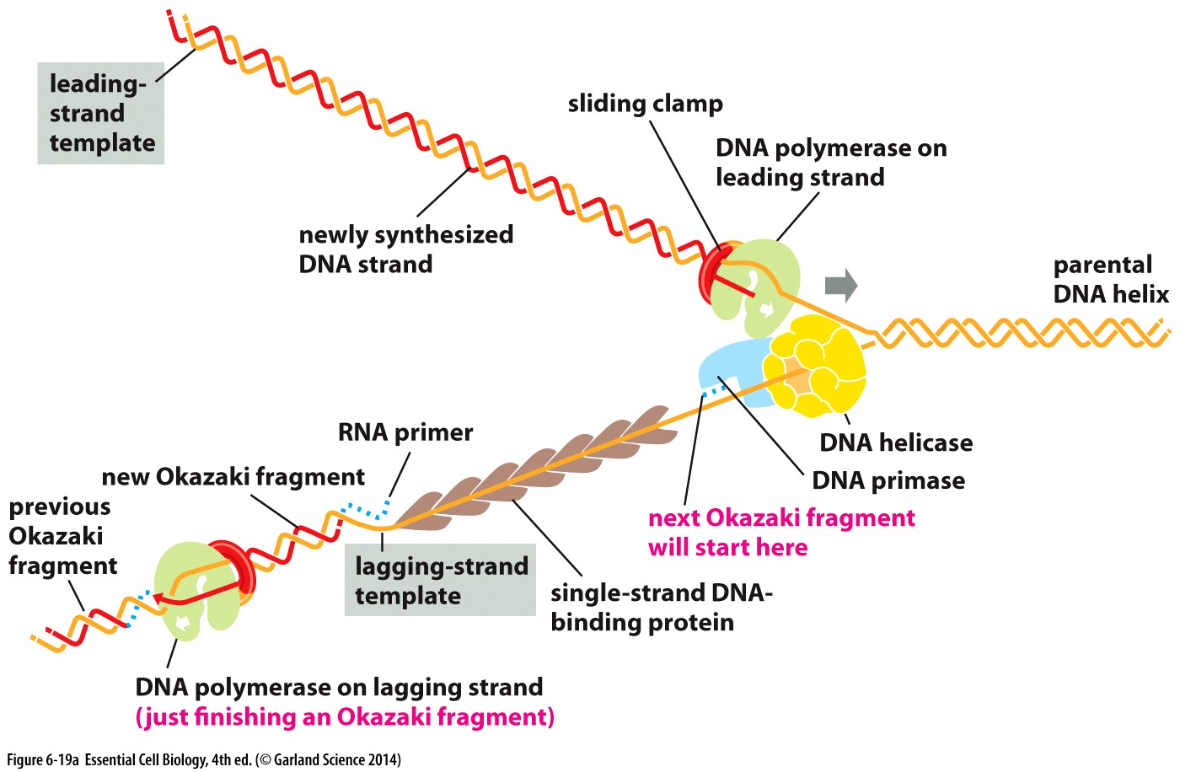
Replication creates challenges
This is not a ‘free’ end!

Slide 23
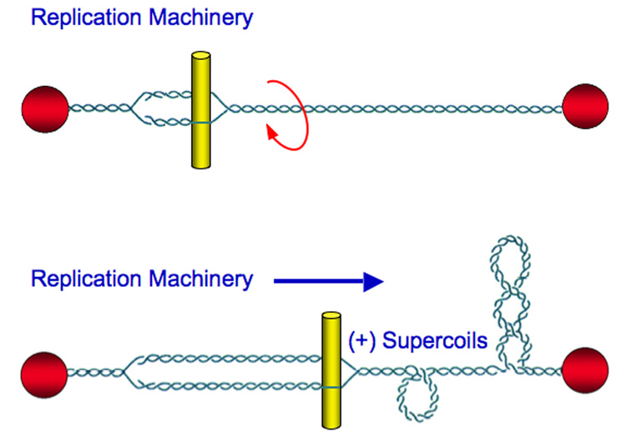
During replication…
Number of turns doesn’t change, just compressed into a shorter segment of DNA.
The double helix becomes increasingly overwound ahead of the replication fork.
Supercoiling makes it increasingly more difficult to open the two strands of the double helix
ultimately this would block further replication

Slide 24
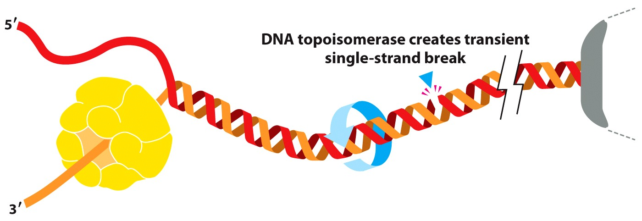
During replication…
Replication fork
Topoisomerase → enzyme that makes a nick in the DNA backbone
Free rotation around the phosphodiester bond on unbroken strand to relieve torsion
Nick is re-sealed and topoisomerase is removed

Slide 25
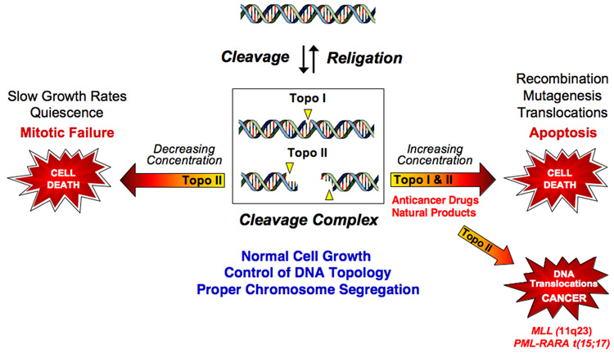
Topoisomerase function is essential

Slide 26
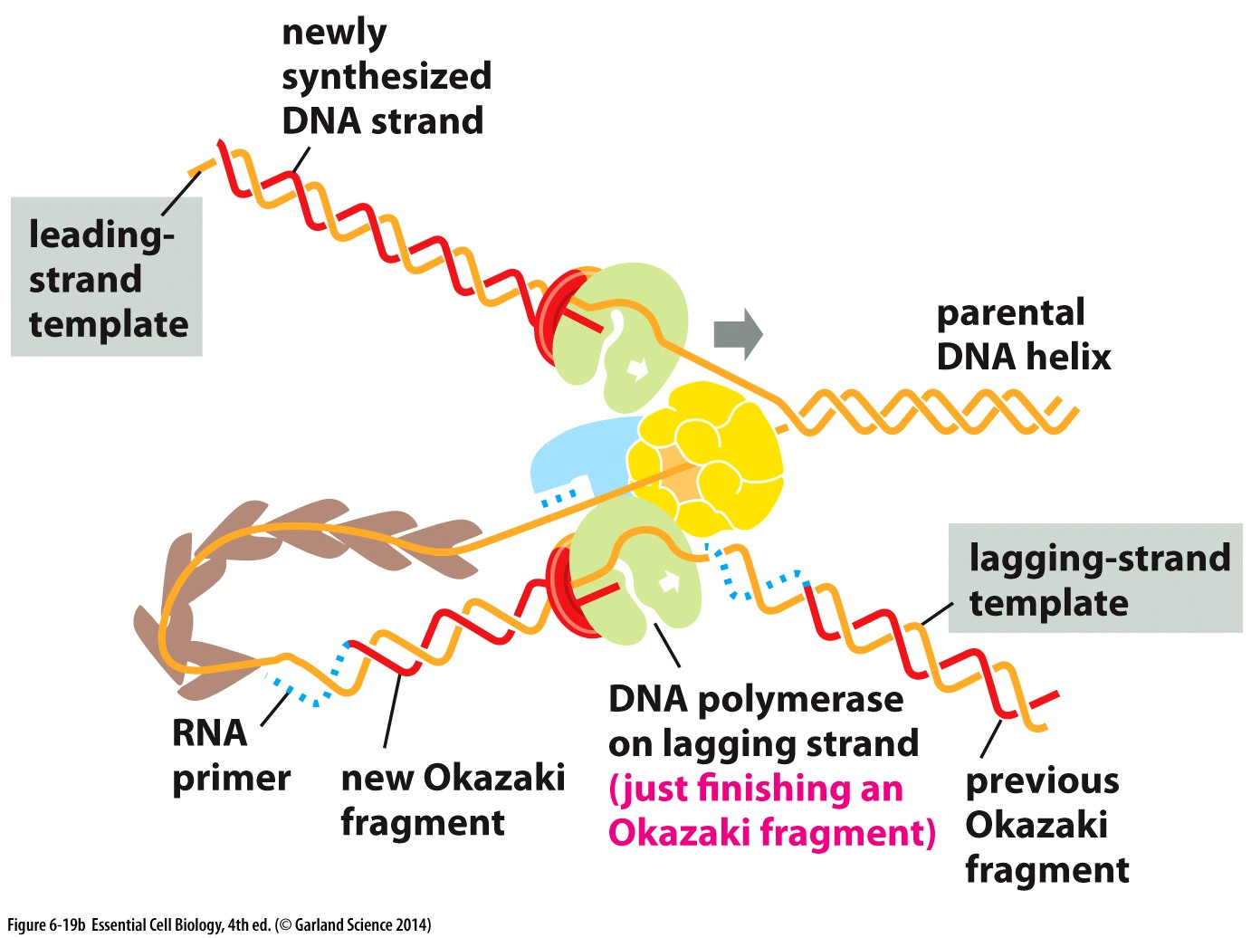
Replication Machinery
RNA polymerase remains at the fork
Lagging strand folds back to keep both DNA polymerases near the fork
Both primase and DNA polymerase remain local and read to produce the next okazaki fragment
Proteins act together for efficient, effective replication

Slide 27
Replicating telomeres
A special challenge

Slide 28
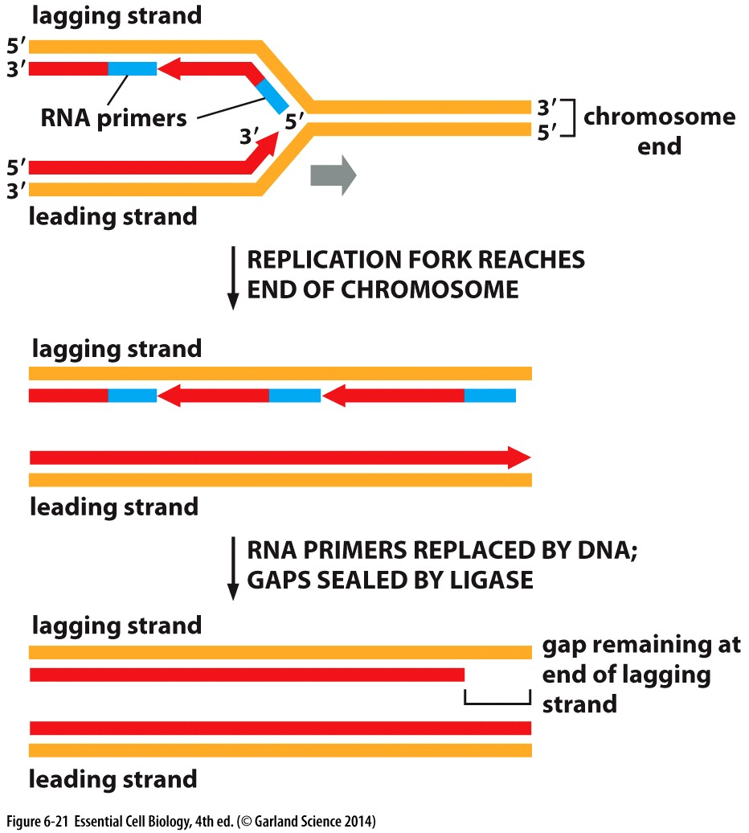
On lagging strand:
Once RNA primer is removed, there is no longer a 3’ base-paired end to allow DNA polymerase to complete replication
Over repeated rounds of replication, DNA strand continues to shrink…..

Slide 29
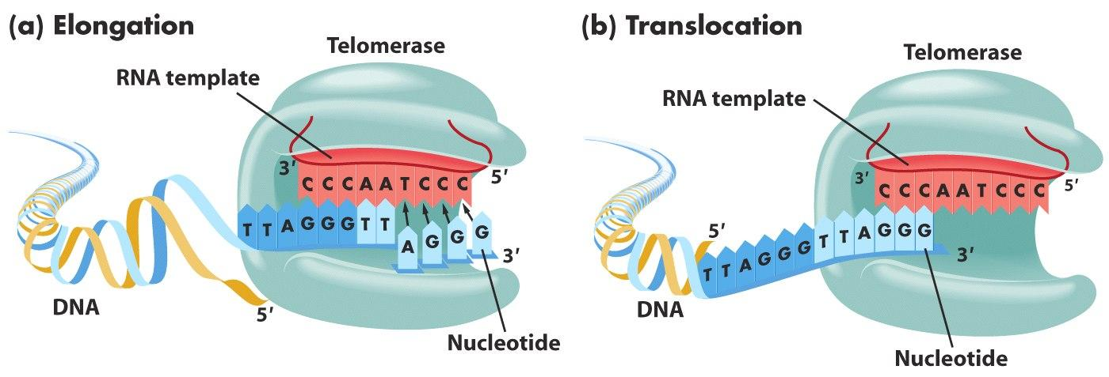
RNA to the rescue again!
Telomerase → an enzyme that uses an RNA template to extend the DNA replicated from the lagging strand

Slide 30
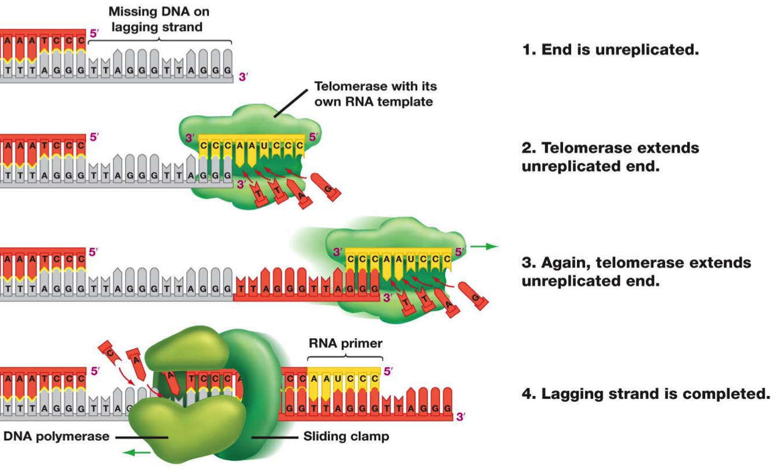
RNA to the rescue again!
RNA sequence
CCCAAUCCC
Telomere ends are complementary to the telomerase RNA’s sequence

Slide 31
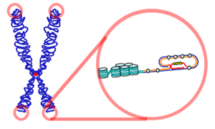
Telomeres present more challenges
Telomerase solves the problem of shortening chromosomes
BUT there is still single stranded DNA….
Specific sequence of
telomeres allows
special looping
structure

Slide 32
Enzymes that make it all possible…
Challenge
Solution
Starting replication
RNA/DNA hybrid
Unwinding to open replication bubble
Too much unwinding
Shortening DNA ends
Primase, then DNA polymerase
Nuclease & ligase
Helicase
Topoisomerase
telomerase

Slide 33
Dna damage
Mismatch repair

Slide 34
Assault on your genome
The human body has ~30 trillion cells
~10,000 trillion cell divisions in a lifetime
200 million cells are replicating DNA and dividing in your body RIGHT NOW
Daily exposure to DNA damaging factors:
Lifestyle factors (nutrition, tobacco use, etc)
Naturally occurring exposures (UV light, infectious agents)
Medical treatments (chemotherapy)
Workplace and household exposures
Pollution
Each round of replication is an opportunity for new mutations to be acquired and passed on

Slide 35
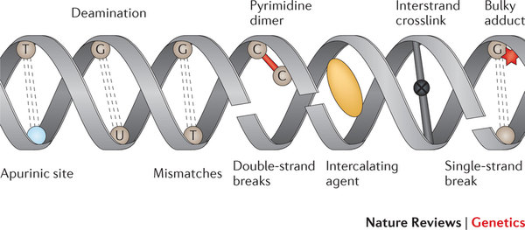
Common types of damage
Caused by both endogenous and exogenous sources
Mismatch errors during replication 1:10,000,000
2 of the more common: deamination and depurination
N-glycosidic bond that attaches the base to the sugar of a nucleotide is easily broken
Occurs with 10^4 bases per cell per day!

